Slide 1
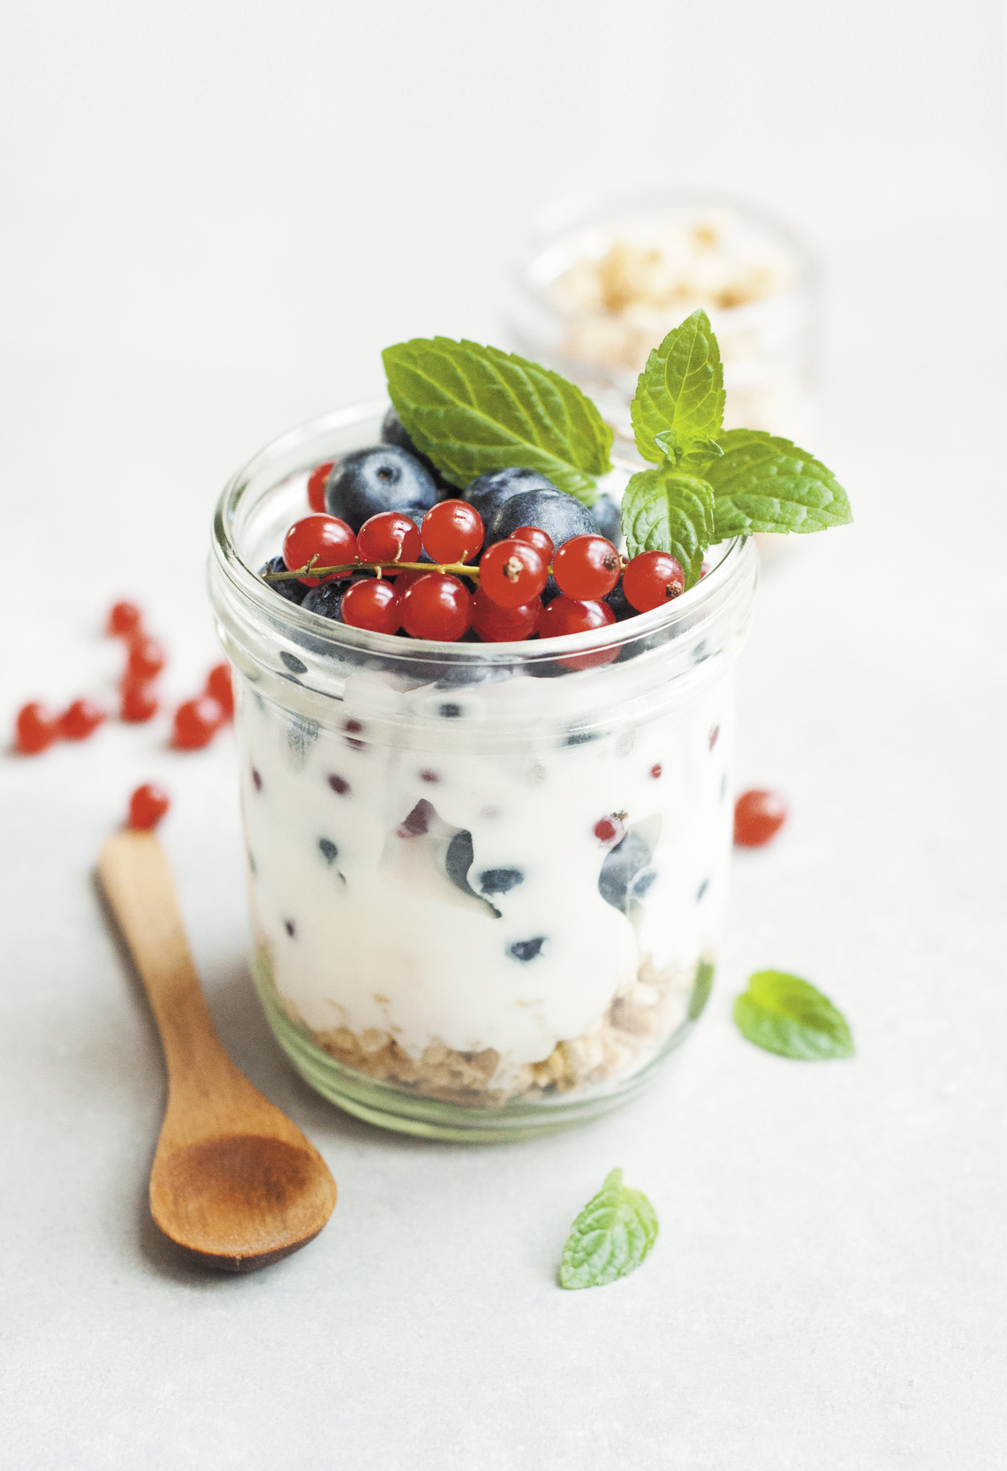

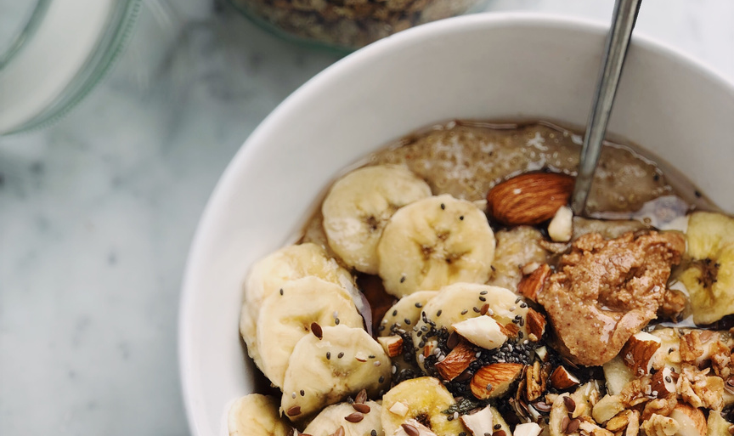
NUTRITION
Educational Presentation
Link to edit powerpoint in Canva:
https://www.canva.com/design/DAFX8rYQOnI/PwH63eCdiStGNekkxcctjw/edit?utm_content=DAFX8rYQOnI&utm_campaign=designshare&utm_medium=link2&utm_source=sharebutton

Slide 2
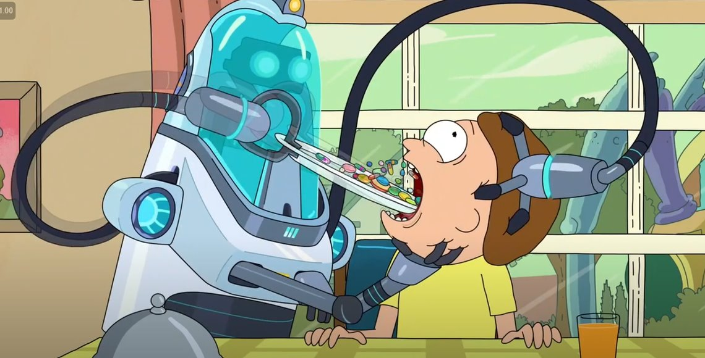

Slide 3
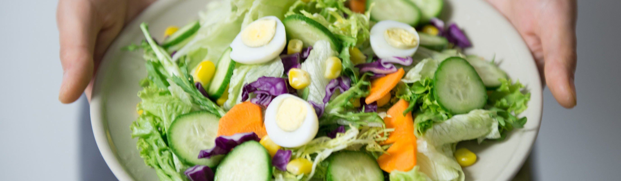
A HEATLHIER DIET,
A HEALTHIER WORLD
Link (https://www.youtube.com/watch?v=XMcab1MFaLc)

Slide 4
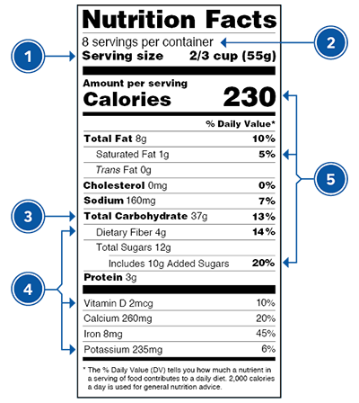
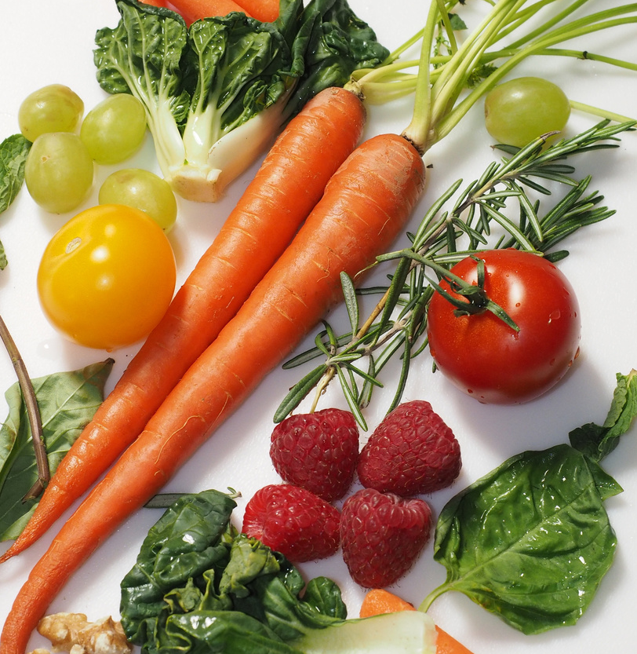
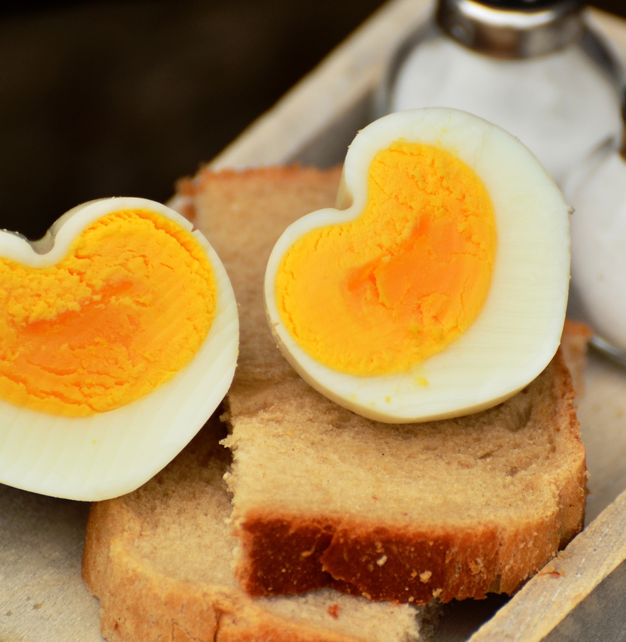
FOOD LABEL CHALLENGES!
Be on the look out through out the presentation for food label challenges.

Slide 5
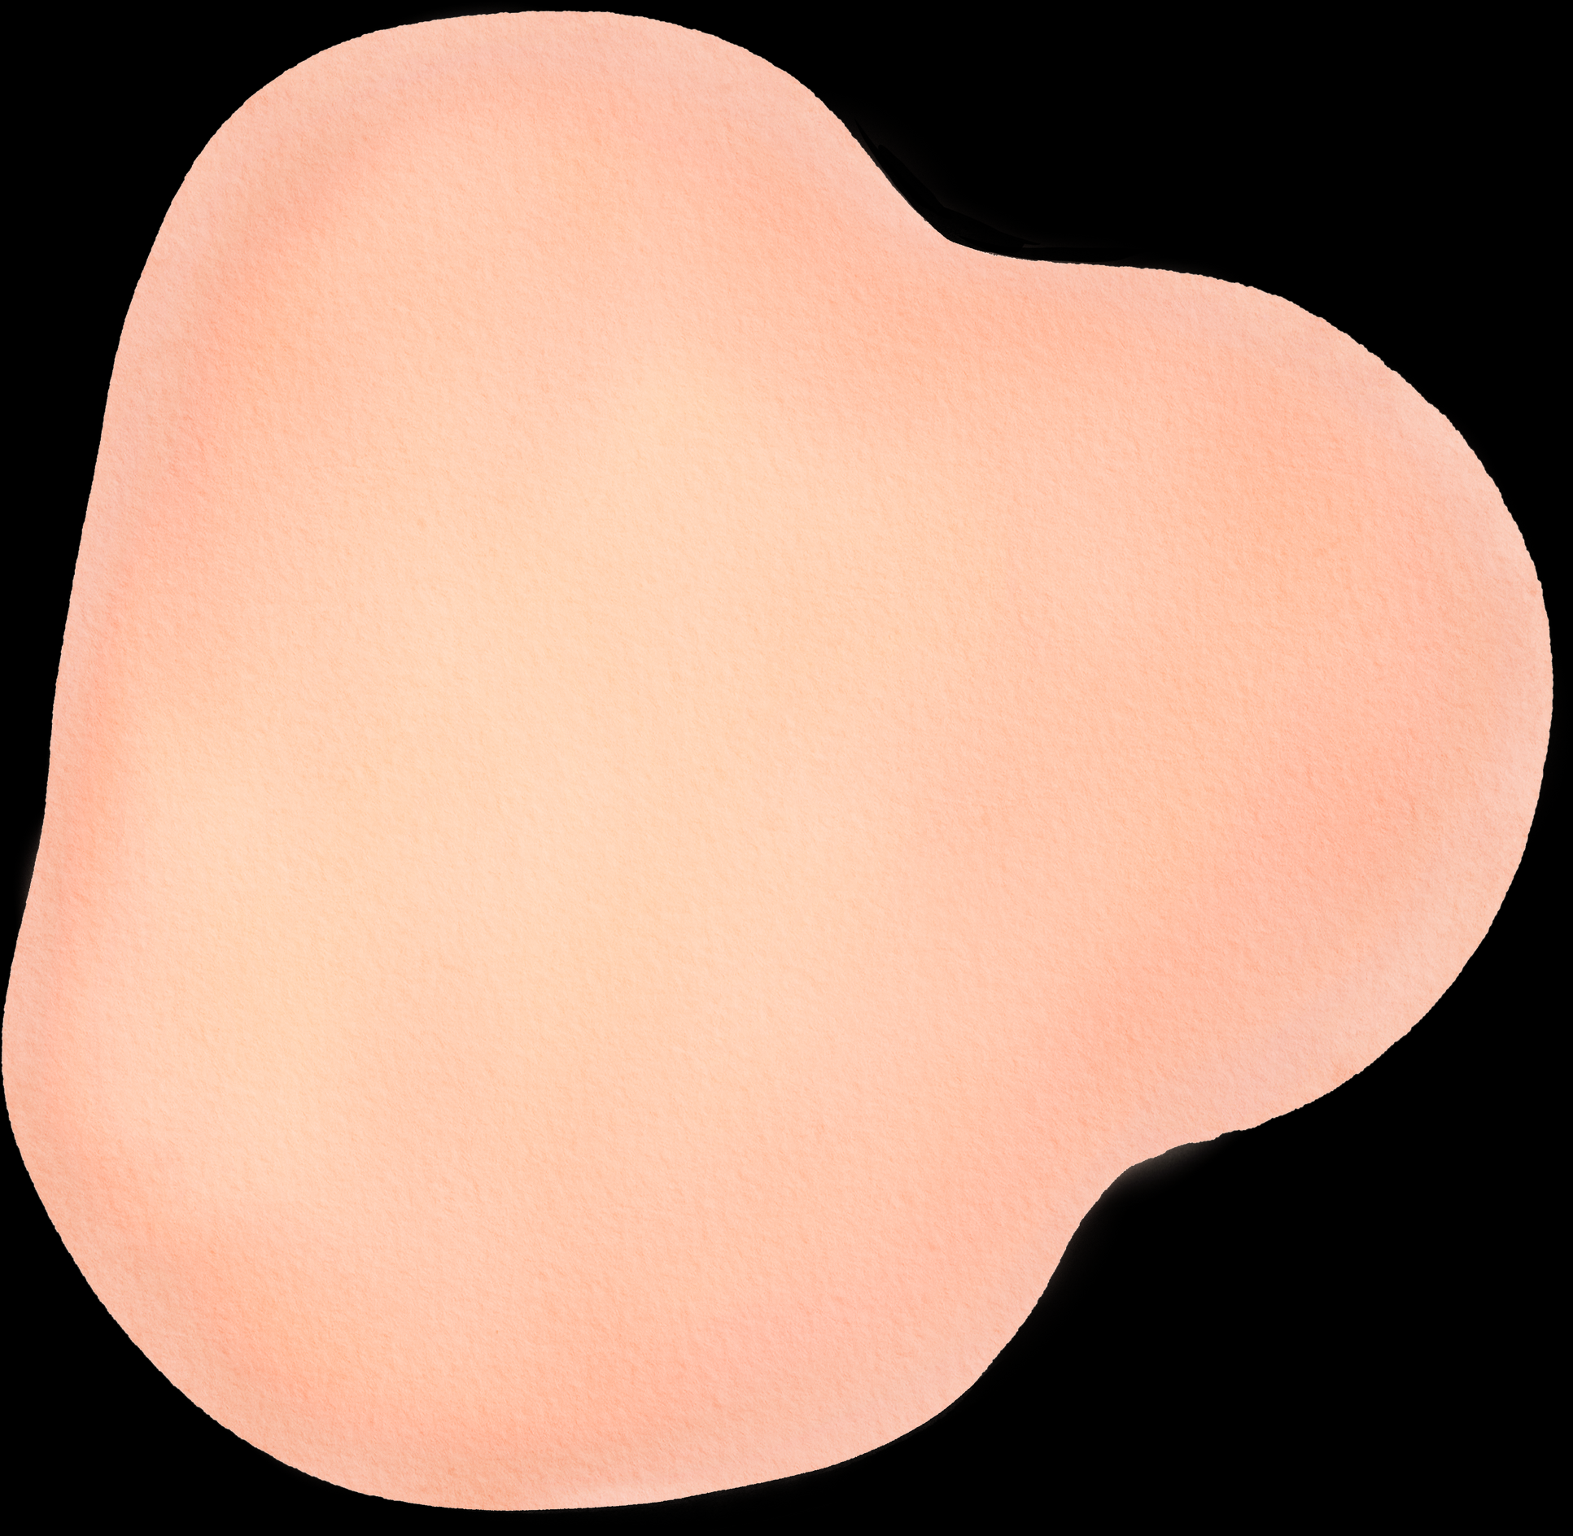





WHAT MAKES YOU, YOU?

Slide 6
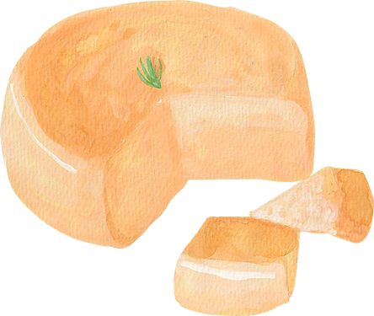
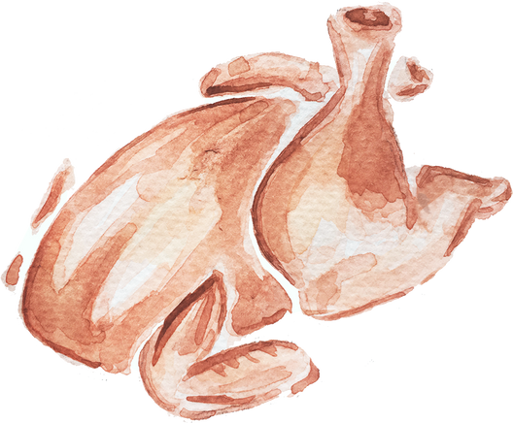
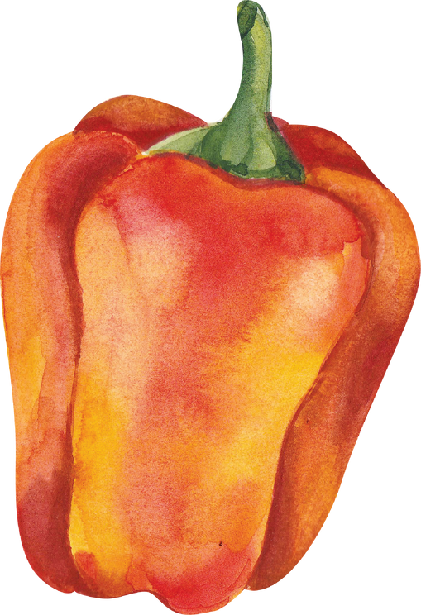

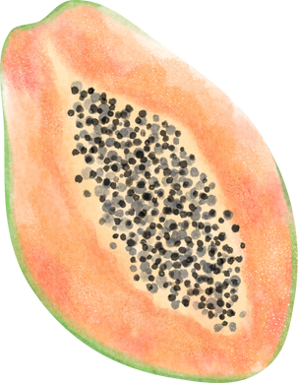
THE FIVE FOOD GROUPS
Dairies
Proteins
Elaborate on what you want to discuss.
Elaborate on what you want to discuss.
Vegetables
Fruits
Grains
Elaborate on what you want to discuss.
Elaborate on what you want to discuss.
Elaborate on what you want to discuss.

Slide 7
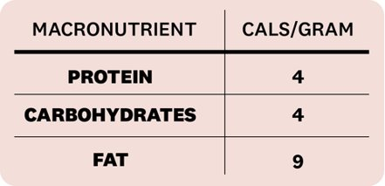
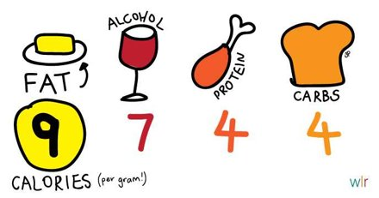
CALORIES PER GRAM

Slide 8
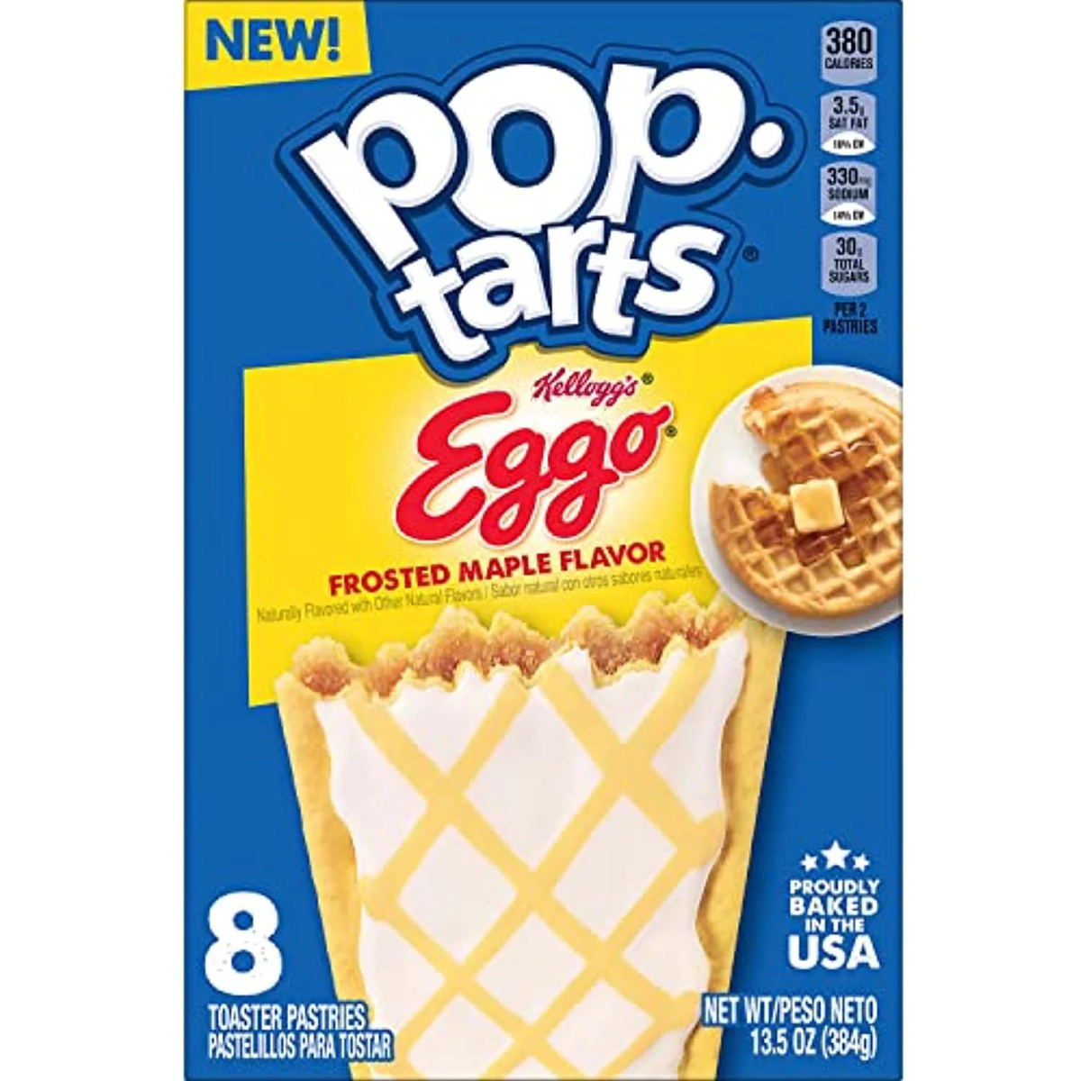
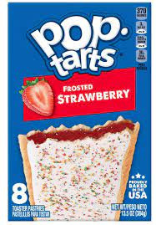
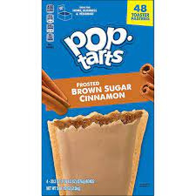
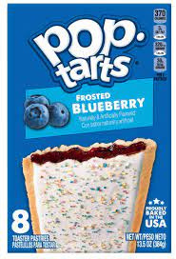
FOOD LABEL CHALLENGE!

Slide 9
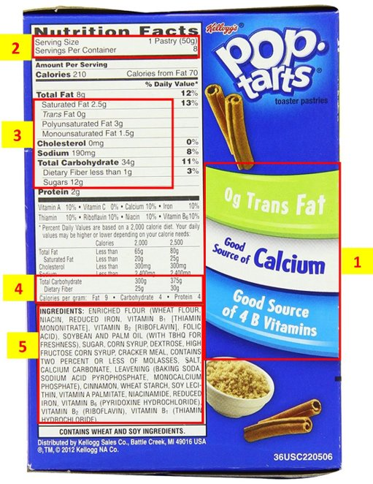
QUICK!
Find ONE unhealthy or deceiving flaw with this food label.
​
Hint: There is more than one!​

Slide 10
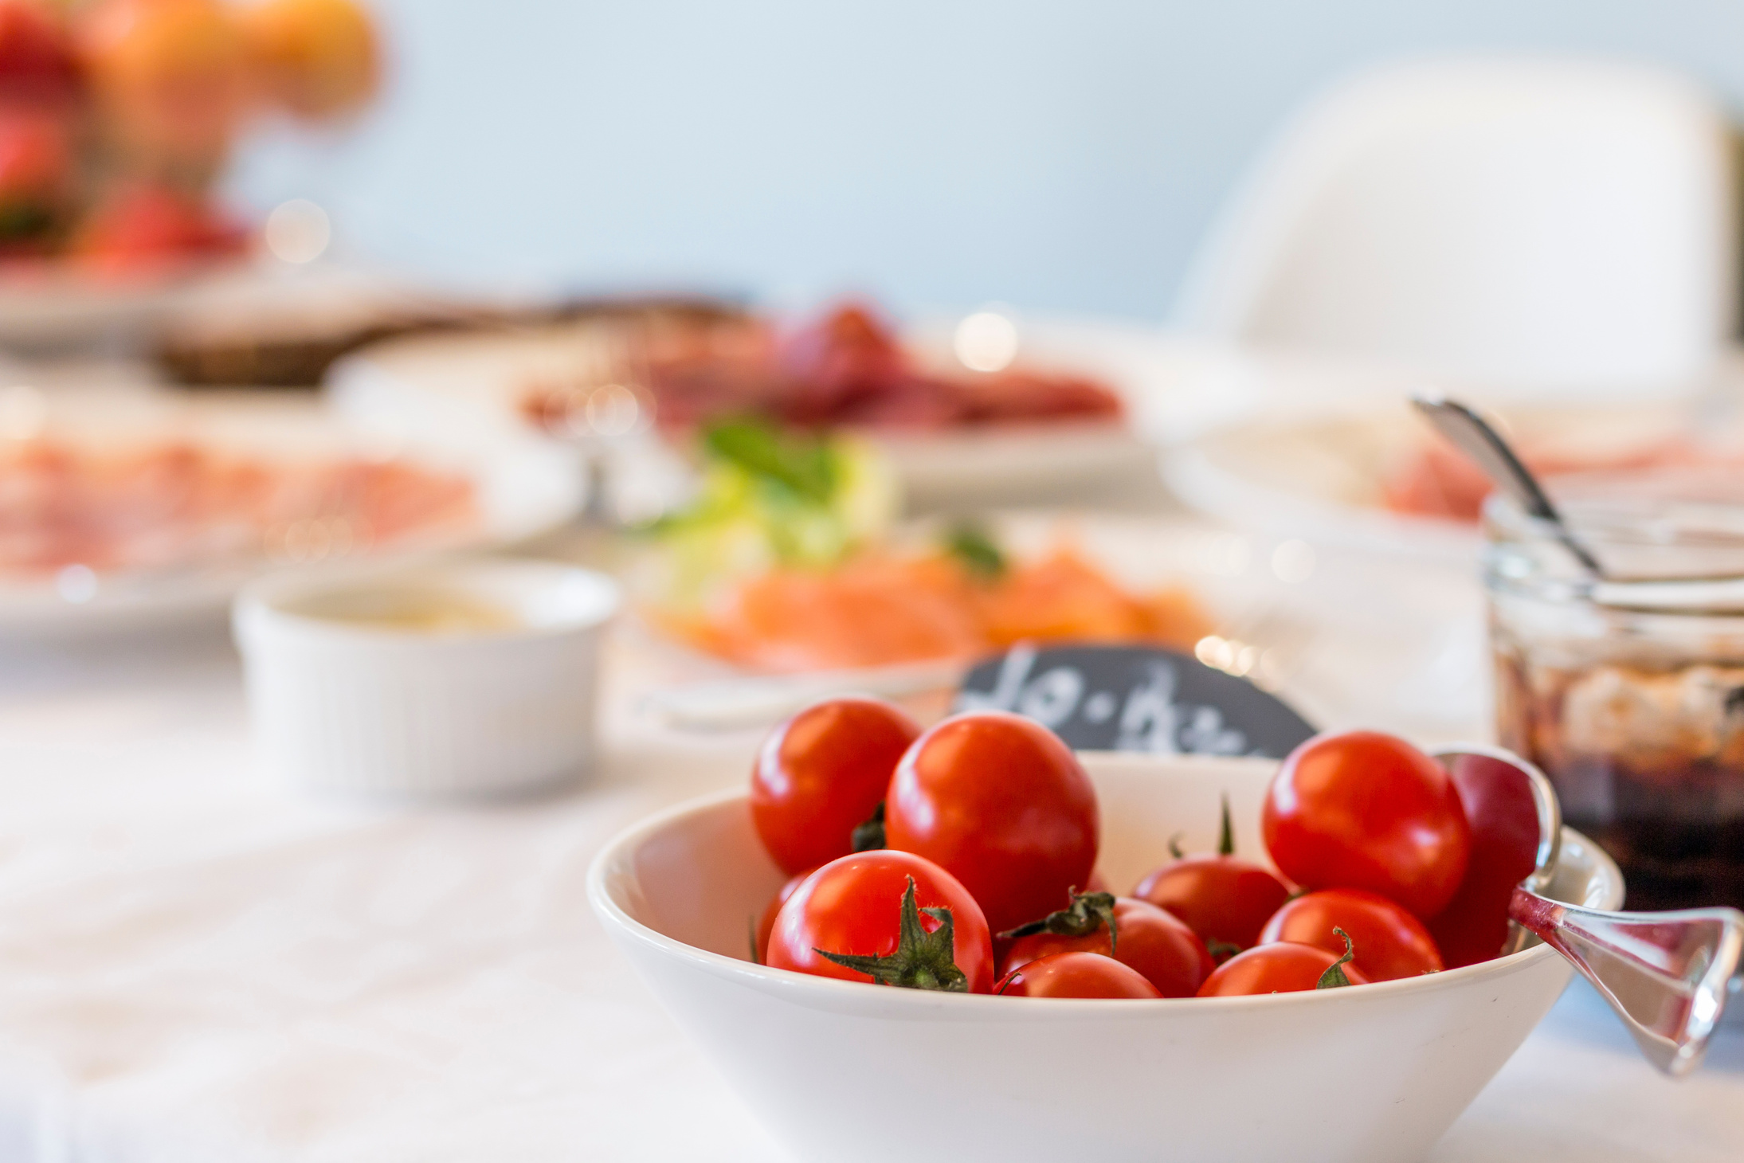
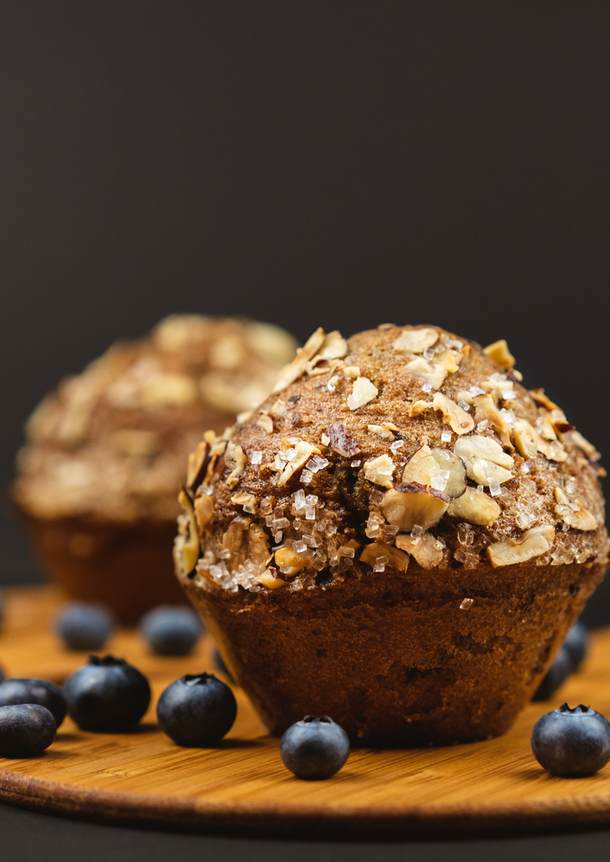
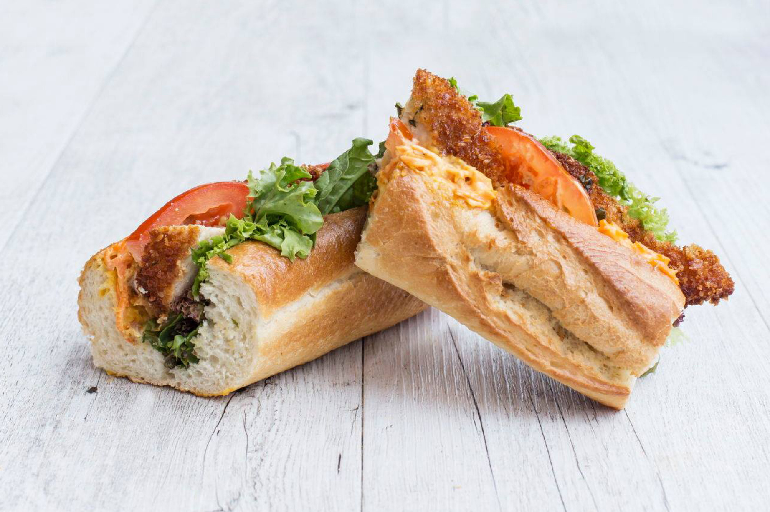
CARBOHYDRATES

Slide 11

CARBOHYDRATES
Role: To provide energy.​
How: Carbs --> glucose --> ATP ​
ATP is the main power source of our body. ​
Note: other foods like fats and proteins can also be broken down to produce ATP..... however the body is very efficient at using carbs as its main source of energy.

Slide 12
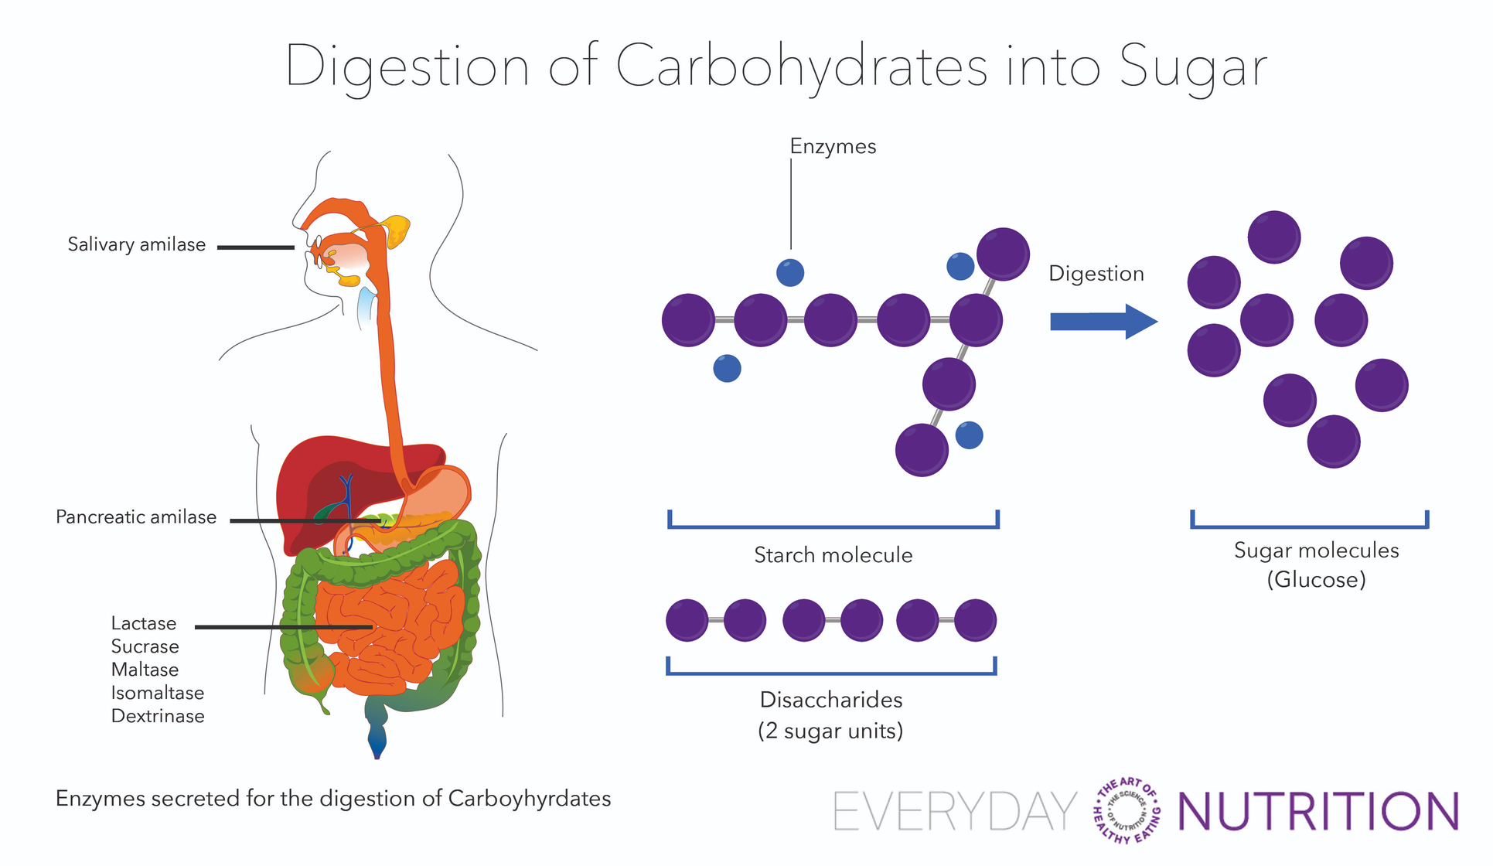


DIGESTION OF CARBS INTO SUGARS
ATP
Mitochondria
"Powerhouse
of the Cell"

Slide 13
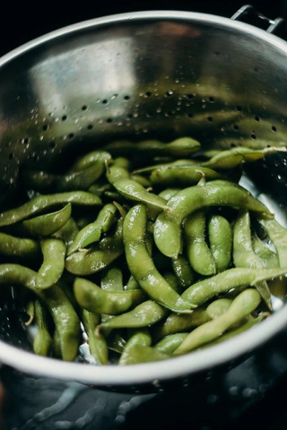
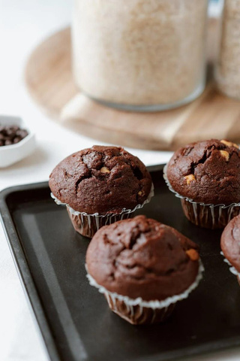
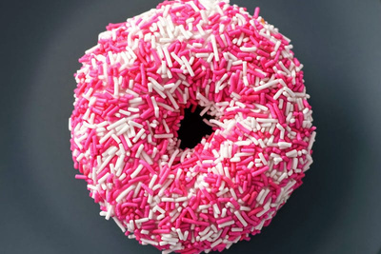


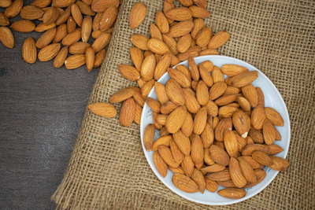
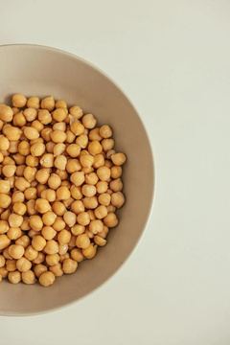
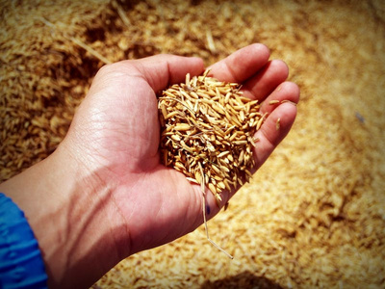
SIMPLE CARBS
COMPLEX CARBS
"HEALTHY"
Gives you an instant burst of energy.
Causes a spikes in blood sugar levels (hence the name "Sugar Rush" & "Sugar Crash".
Includes all sugar types and anything made with "sugar".
Examples: soda, candy, white table sugar
Made up of polysaccharides, which are not digested that quickly.
Mainly used by the body as a sustained source of energy.
Examples: whole grains, starchy vegetables, legumes & nuts.

Slide 14
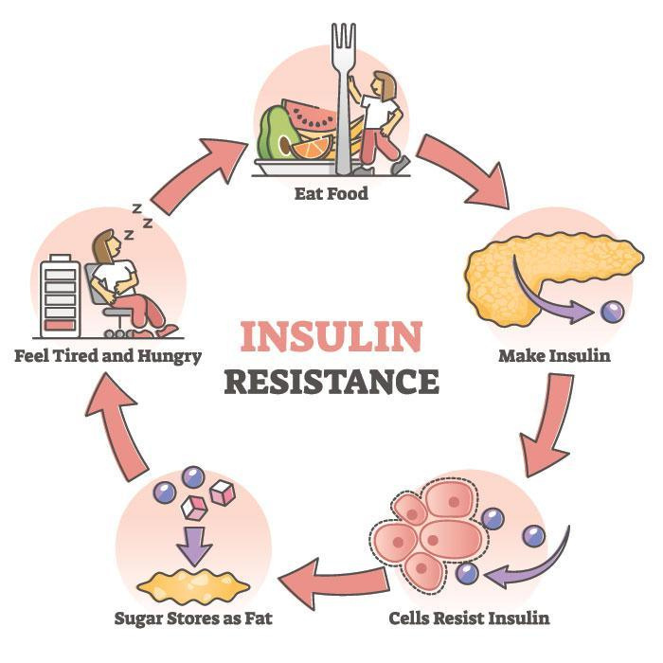
INSULIN RESISTANCE

Slide 15
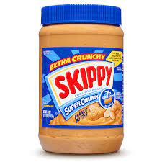
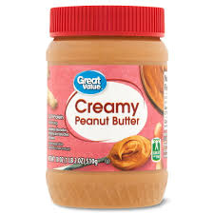
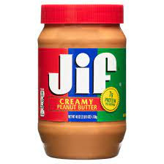
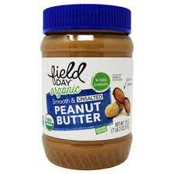
FOOD LABEL CHALLENGE!

Slide 16
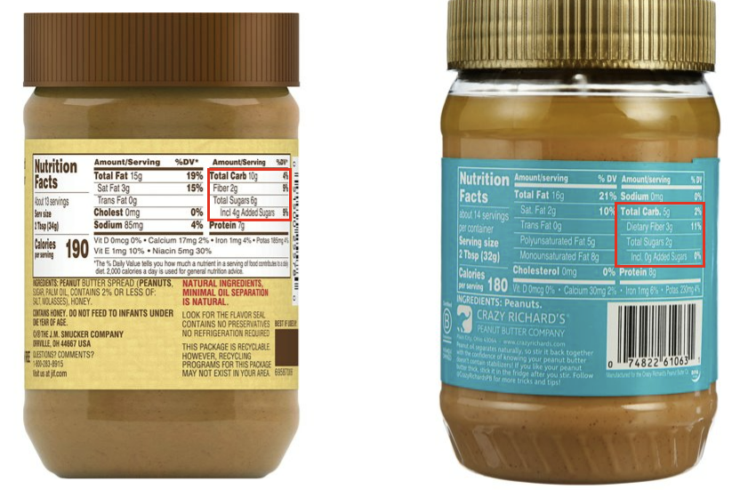
QUICK!
Find the difference between these 2 peanut butters!​
Hint: Look at the carbs!

Slide 17
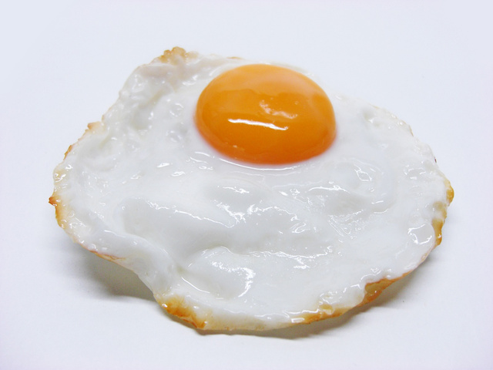
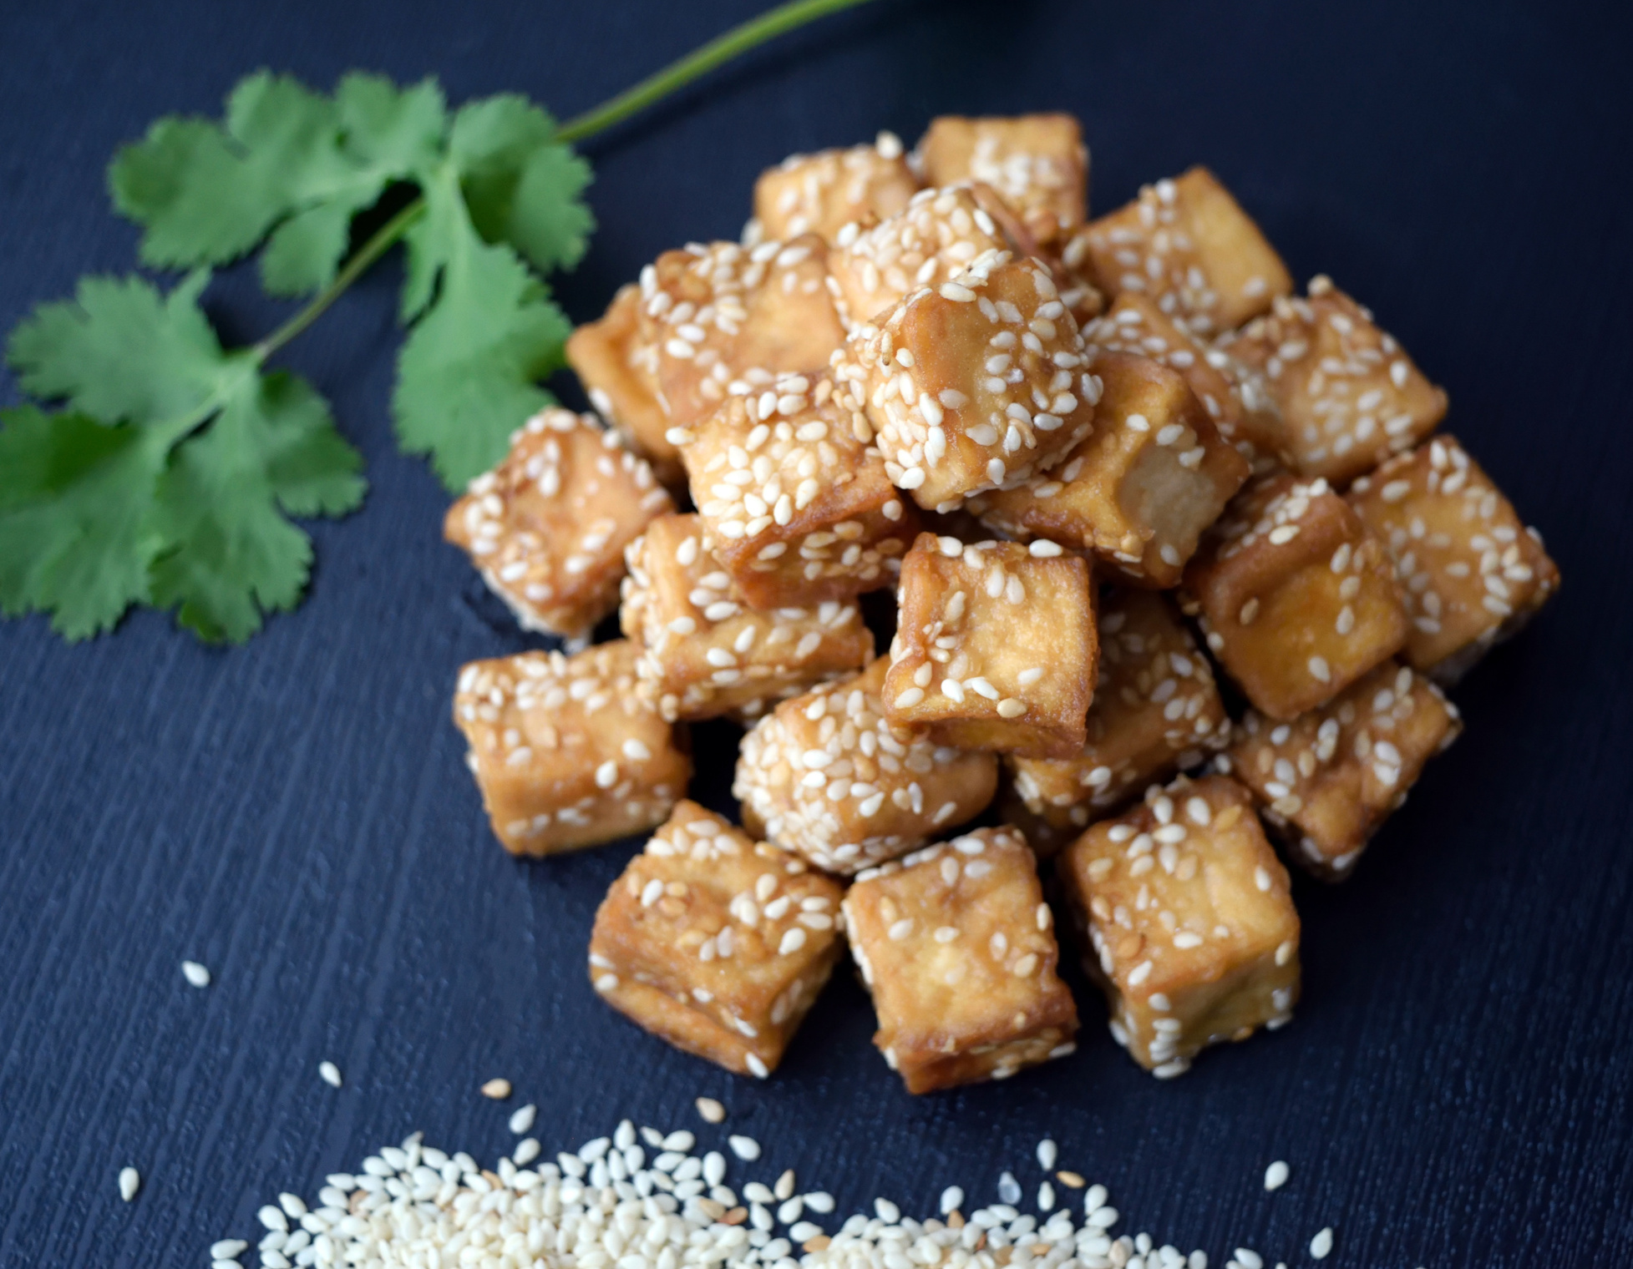
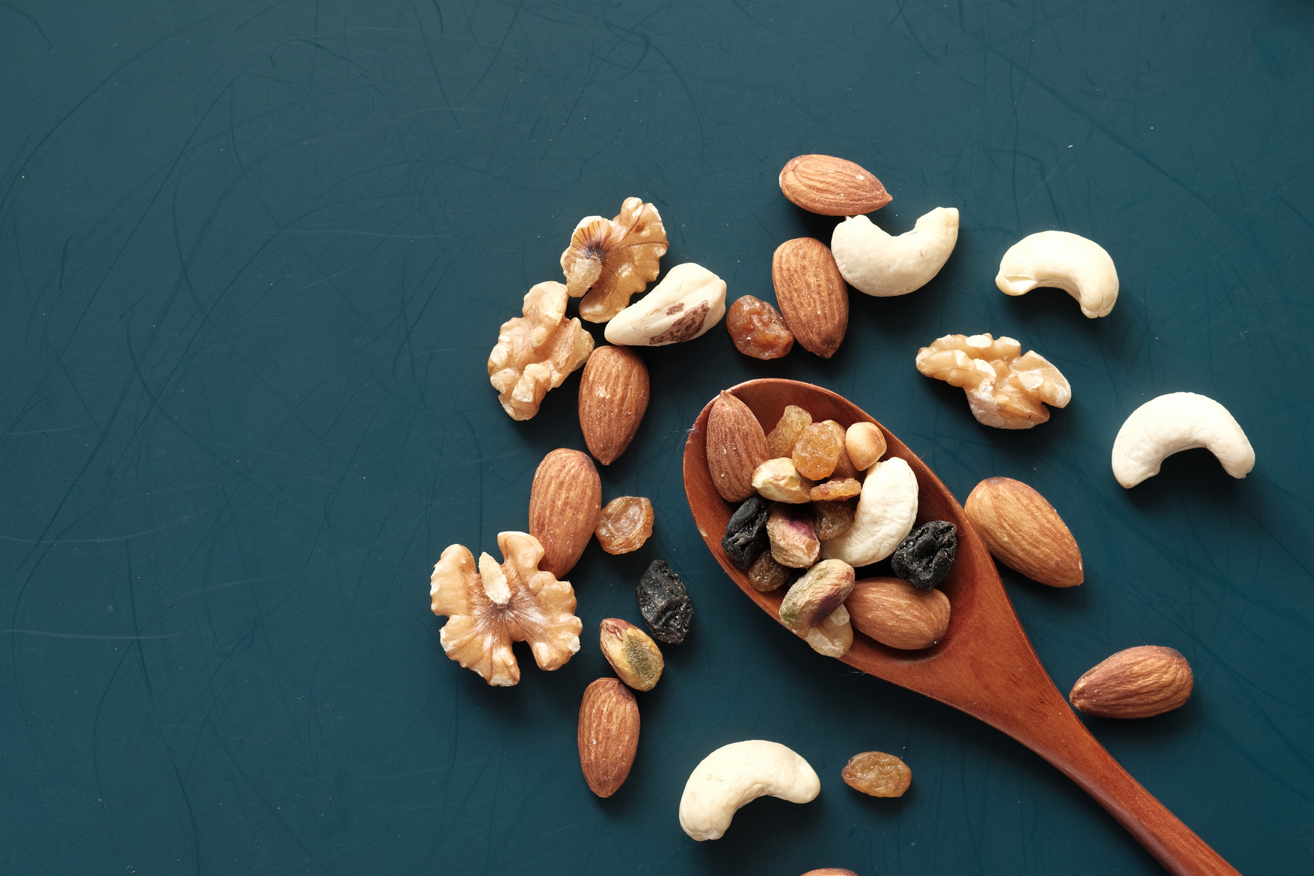
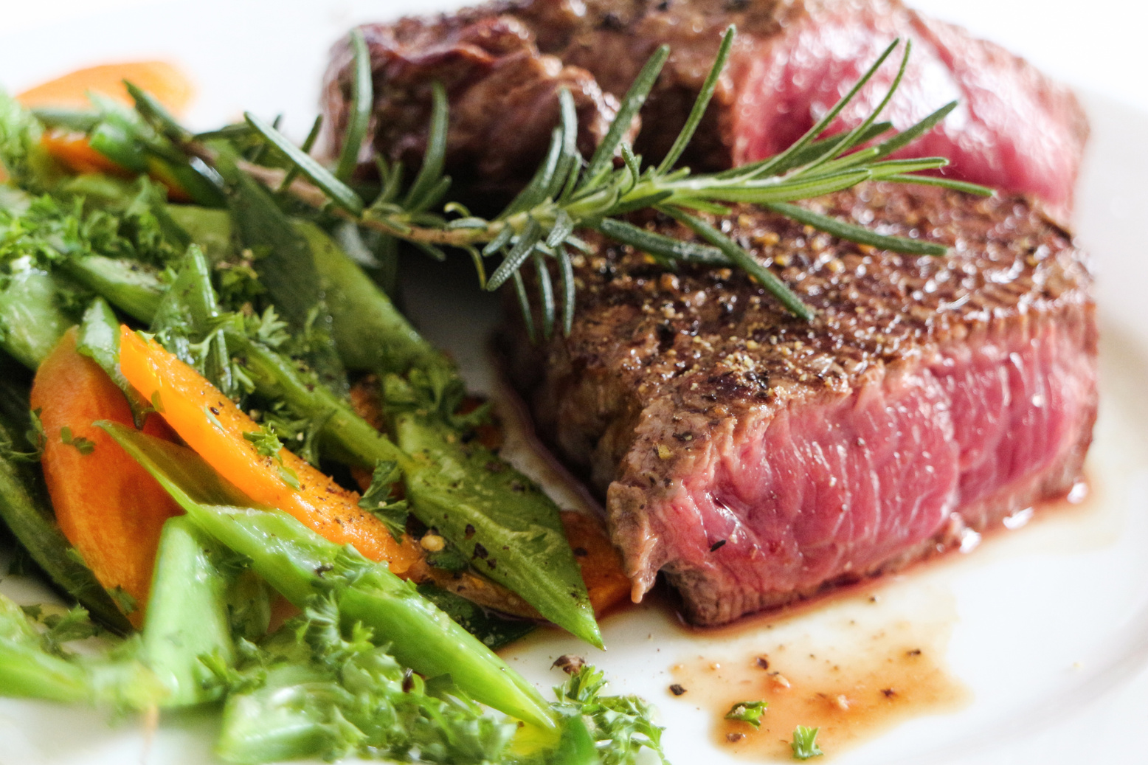
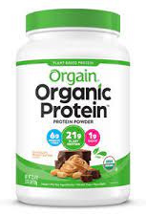
PROTEIN

Slide 18
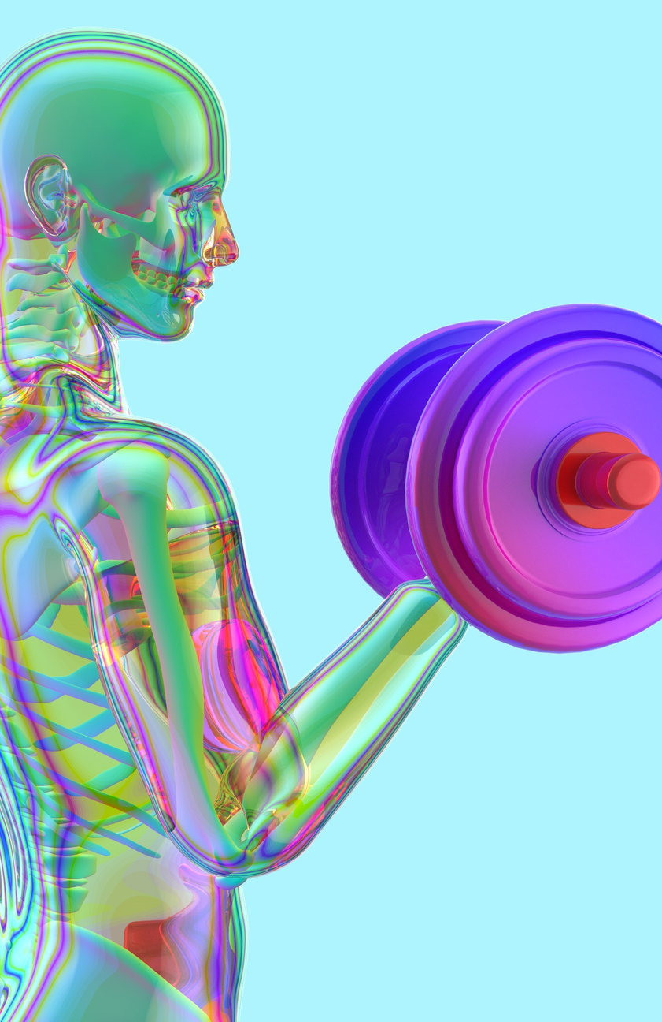
PROTEIN
Help build, maintain, and repair body cells and tissues​
Make up bone, muscles, and cartilage​
Used to make enzymes, hormones, and antibodies​
Essentially every major process in your body involves proteins in some way shape or form

Slide 19
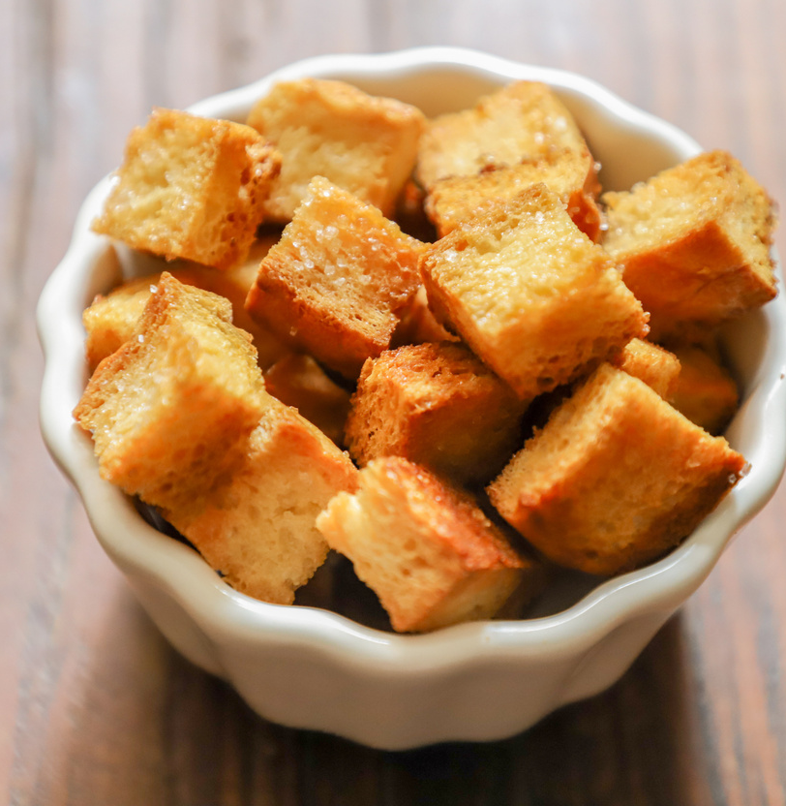
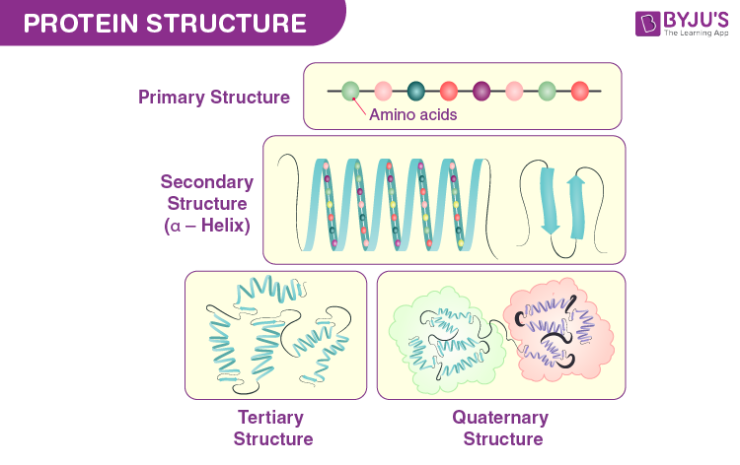
WHAT IS A PROTEIN MADE OF?
A chain of amino acids
20 different kind of amino acids
Our body can't produce 9 of them!

Slide 20
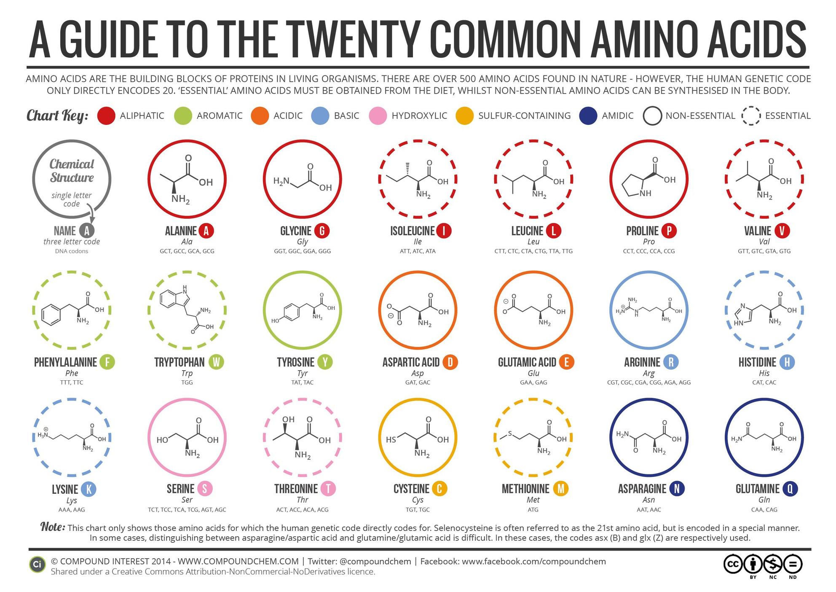

Slide 21

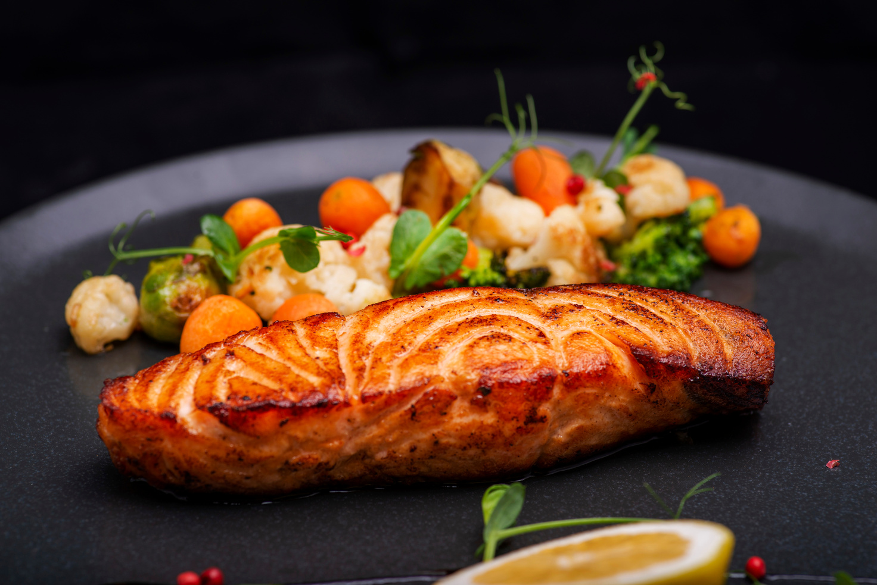
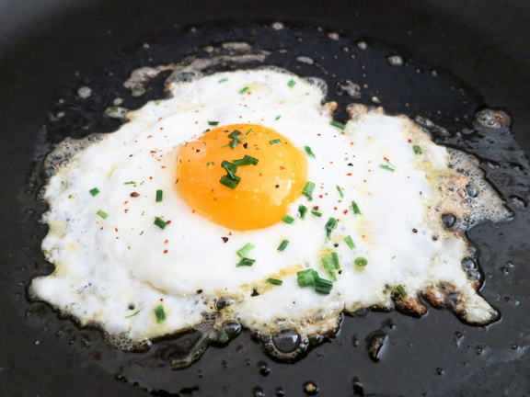
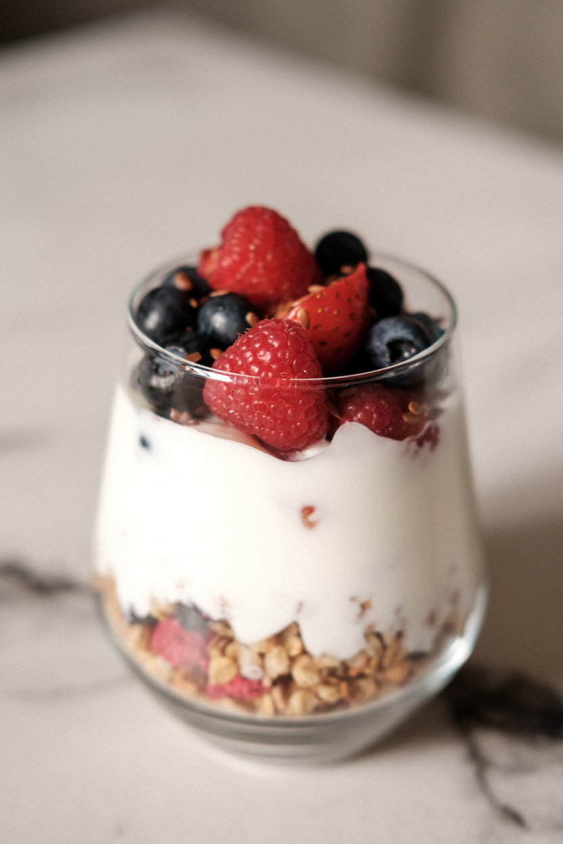
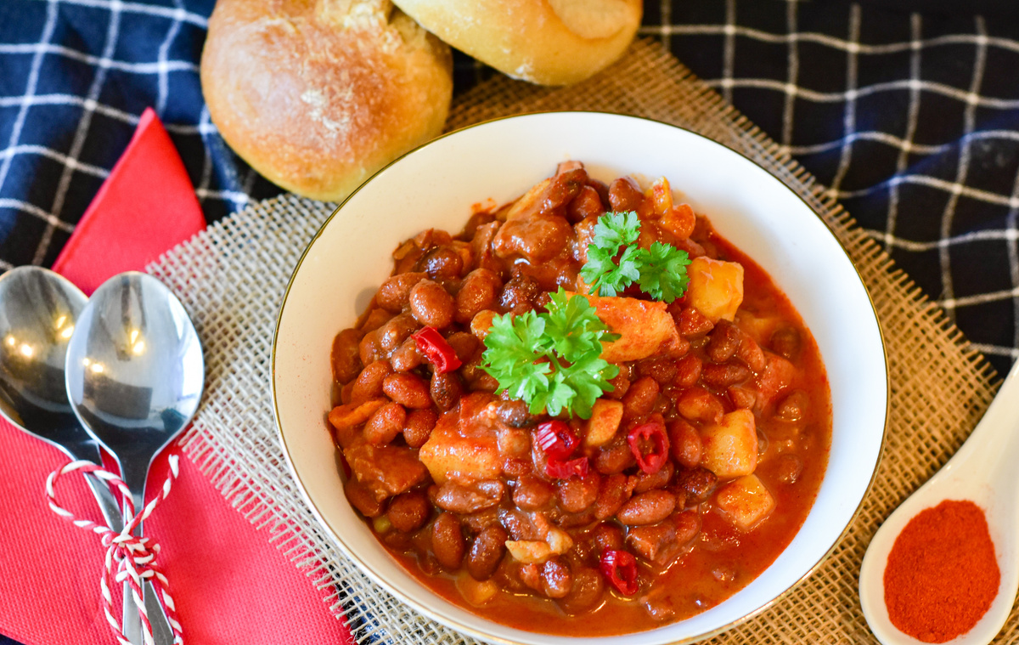
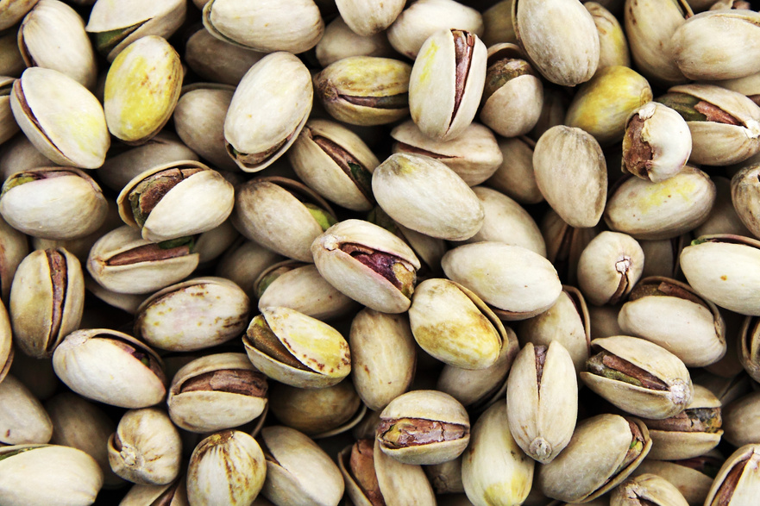
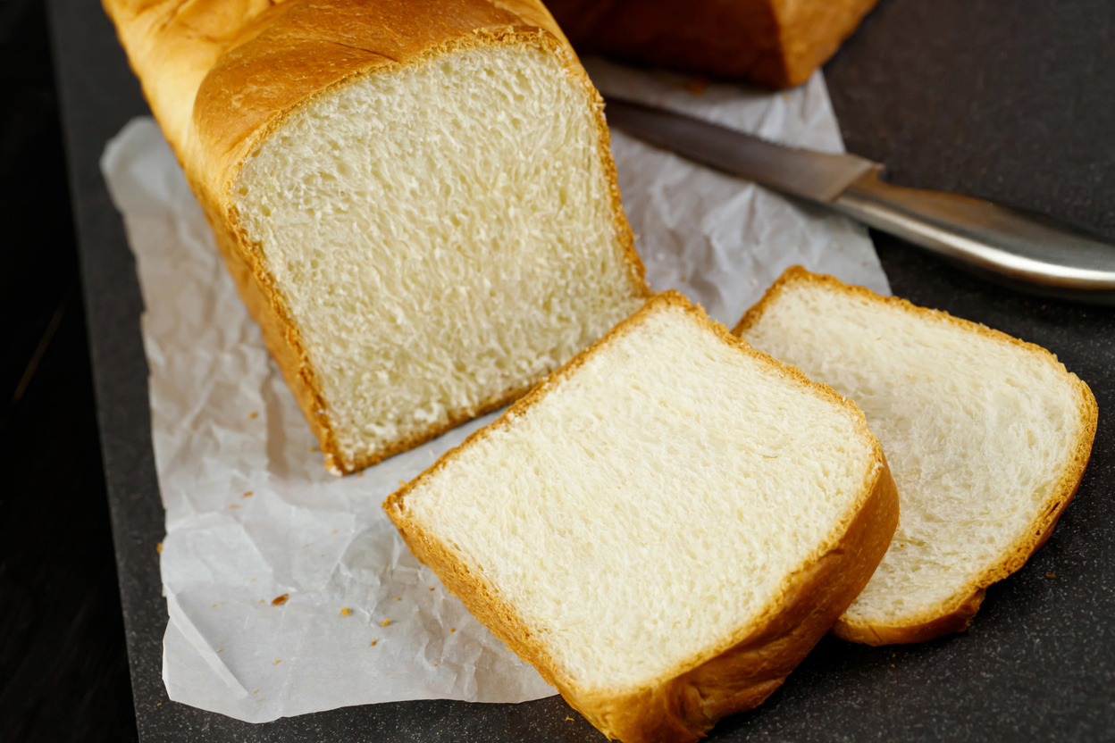
COMPLETE PROTEIN
INCOMPLETE PROTEIN
Contains all 9 essential amino acids!
Fish, meat, poultry, eggs, milk, cheese, yogurt, etc.
DO NOT contain all essential amino acids!
Beans, peas, nuts, whole grains, etc.
Both plant and animal sources of protein can be a part of a healthy diet!​

Slide 22


CREATINE
Natural substance found in beef, pork, fish.​
​
Role in the body is to add a phosphate to ADP to make the ATP that cells need for energy. ​
​
Taken to promote athletic performance. and reduce recovery time. ​
​
​

Slide 23
PROS OF CREATINE
CONS OF CREATINE
May improve high intensity intermittent speed training. ​
May amplify the effects of resistance training to enhance strength. ​
May improve exercise performance and muscle mass.​
The safety or effectiveness of creatine has not been studied on people under 18 years old.​
Supplements like creatine and pre-workout are not monitored by the FDA and may carry risk of contamination with heavy metals or other harmful chemicals.​

Slide 24




FOOD LABEL CHALLENGE!

Slide 25

QUICK!
Find the difference between these two!​
Hint: Look at the fats!

Slide 26




FATS

Slide 27




ARE FATS BAD?

Slide 28

FATS
Transports Vitamins A, D, E, and K in blood ​
Storage form of energy​
Source of linoleic acid (needed for growth and healthy skin) ​
Part of the membrane that covers every cell ​
Composes the outer covering of your nerve fibers​

Slide 29

THE TRUTH ABOUT FATS!
There are many different kinds of fats with different chemical structures and different physical properties. ​
You should eat LESS of some fats​
You should eat MORE of other fats​
ALL Fats are BAD = MYTH ​
Fat is an ESSENTIAL part of a healthy diet.​

Slide 30


Slide 31


SATURATED FATS
WHICH FATS ARE GOOD?
WHICH FATS ARE BAD?
UNSATURATED FATS

Slide 32

AVOID THE TRANS FATS, LIMIT THE SATURATED FATS, AND EAT MORE ESSENTIAL POLYUNSATURATED FATS​
The worst type of dietary fat is known as trans fat. It is a byproduct of a process called "partial hydrogenation" that is used to turn liquid oils into semi-solids.​
Adding artificial trans fats to foods is now BANNED in the United States, but you can still find them naturally in foods like butter, ground beef, or those that are deep-fried in oil like french fries, potato chips, fast food, etc.​
Trans fats increase vLDL (bad cholesterol) and decrease HDL (good cholesterol) ——> may contribute to heart problems​

Slide 33

AVOID THE TRANS FATS, LIMIT THE SATURATED FATS, AND EAT MORE ESSENTIAL POLYUNSATURATED FATS​
A diet rich in saturated fats can drive up total cholesterol, and tip the balance toward more harmful LDL cholesterol, which can increase risk for heart disease.​

Slide 34





WITH SATURATED FATS...
MODERATION
IS KEY!

Slide 35
AVOID THE TRANS FATS, LIMIT THE SATURATED FATS, AND EAT MORE ESSENTIAL POLYUNSATURATED FATS​
"GOOD" FATS = essential polyunsaturated fats ​
Eating polyunsaturated fats reduces harmful LDL cholesterol and improves the cholesterol profile.​
They're required for normal body functions but your body can't make them. So, you must get them from food. Polyunsaturated fats are used to build cell membranes and the covering of nerves. They are needed for blood clotting, muscle movement, and inflammation.​
Polyunsaturated fats help your body absorb vitamins A, D, E, and K. They also contribute to energy production

Slide 36




SATURATED FATS
UNSATURATED FATS
Saturated fats are solid at room temperature​
Saturated fats - animal fats, beef, pork, dairy are higher than chicken and fish ​
Unsaturated fats are liquid in room temperature​
Unsaturated fats - olive oil, canola oil, corn oil ​

Slide 37


Slide 38



SOURCES OF INFORMATION
& KNOWLEDGE

Slide 39

PROS OF SOCIAL MEDIA
Easily accessible and free​
Can find good quality information that is helpful and easy to understand​
CONS OF SOCIAL MEDIA
Anyone can post whatever they want​
Hard to tell what is true and what isn't (it can be subtle)​
Bad information can be harmful and misleading​

Slide 40



REVIEW- CARBOHYDRATES
Our body's main source of energy!​
Focus on eating more complex, fiber rich carbohydrate sources like fruits, vegetables, and whole grains and limiting simple sugars like soda, candy, cakes, etc.

Slide 41




REVIEW-
PROTEINS
Made up of smaller molecules called amino acids​
20 total, need to get the 9 essential amino acids from our diet!​
Both plant and animal sources of protein are an important part of a healthy diet

Slide 42


REVIEW-
FATS
Avoid the trans fats, limit the saturated fats, and eat more essential polyunsaturated fats!
Fats help to transport vitamins and build the walls of our cells.

Slide 43

REVIEW-
FOOD & YOU
Different bodies have different needs!​
Healthy eating can help to promote a healthier world. ​
Watch out for tricky nutrition labels:​
Check serving size.​
Check for high amounts of saturated fats, added sugars, or low amounts of vitamins, minerals, or fiber

Slide 44

REVIEW-
SOCIAL MEDIA & NUTRITION
Always double check information that ​you find.​
Can be a great way to find recipes and exercise routines you can do at home.

Slide 45

HEALTHY CHEF CHALLENGE
Divide into groups of 5-6 ​
Create a Team Name​
Create a meal that YOU WOULD EAT and find ingredients​
Document the price and the nutritional contents​
One meal has to be vegetarian​
One meal has to be keto​
3 meals​
2000 calorie limit​
Cannot exceed sodium and added sugar daily intake​
Has 100% daily protein​
3 Vitamins are present ​
Hit two major minerals other than sodium
​

